Slide 1
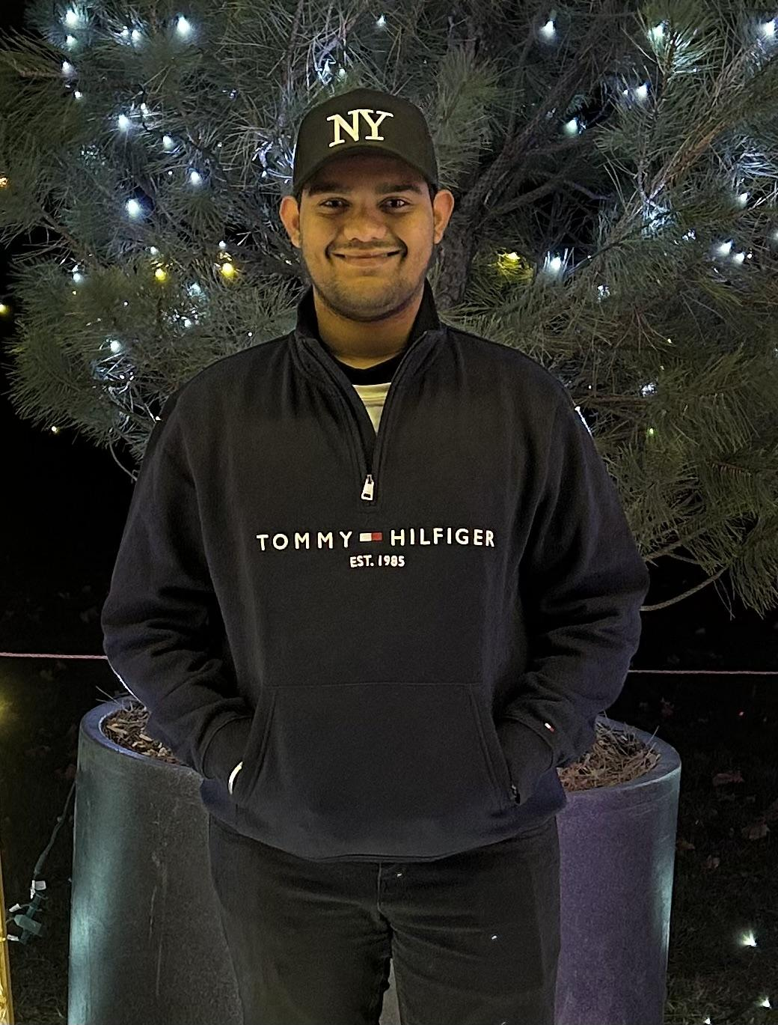
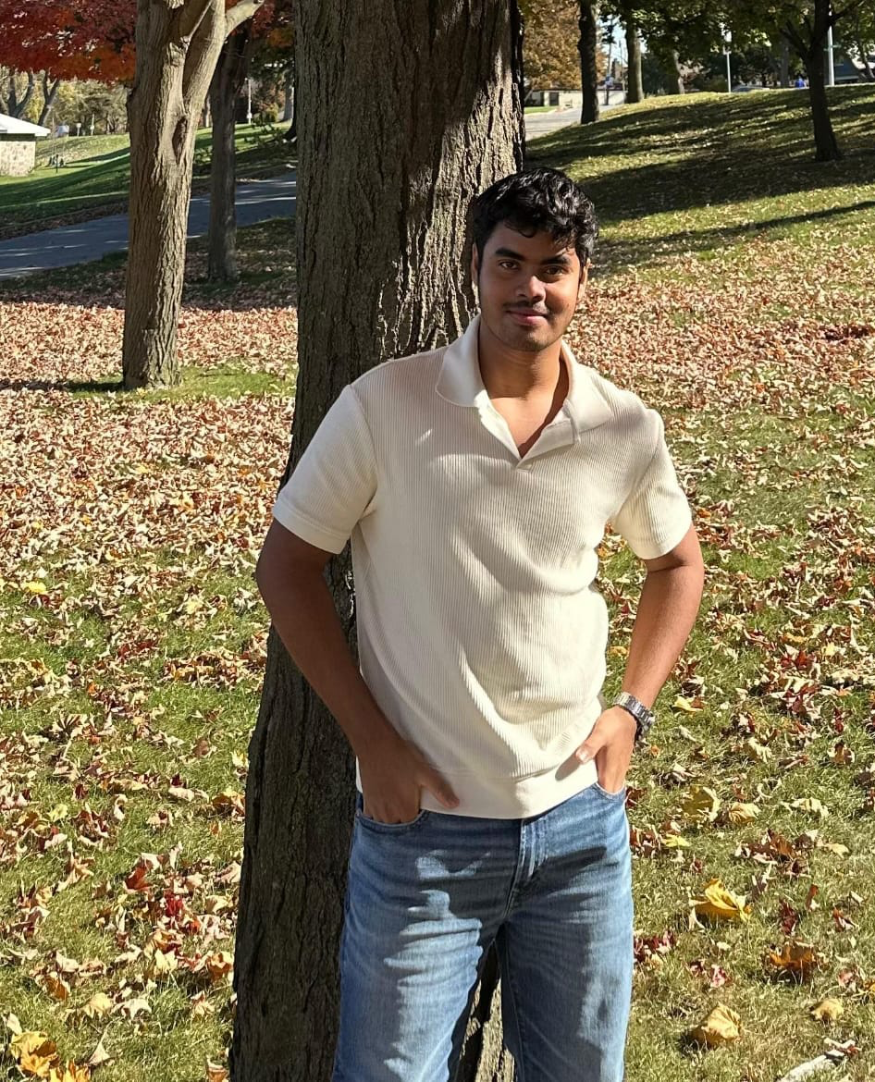
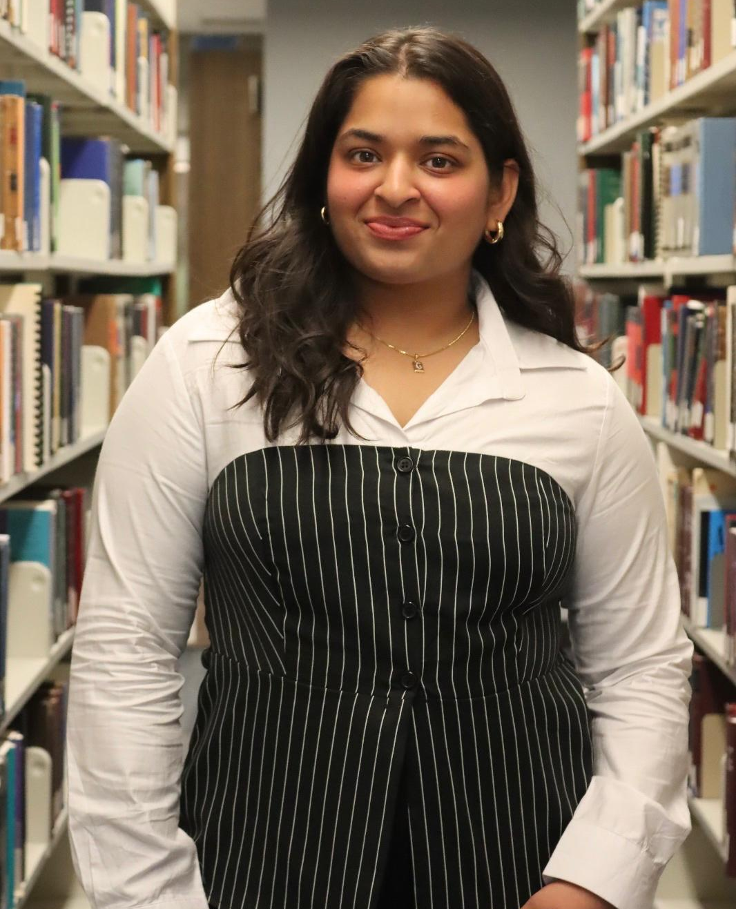


LHDiff : A Line Mapping Tool
Group 5 Members
Mayank Khavshe
Sunny Kumpati
Aesha Patel
Nithin Varughese
Grishma Bakhedi

